Slide 1
Project 1: Web Scraper Using R
By:
Roque Nido
Rushin Patel
Nagesh Nandamuri

Slide 2
Work Timeline
Journal Selection (Week 1)
Discussed different options and decided on February 23, 2023 to select Cancer Informatics
Background and Research(Weeks 2 and 3)
Spent these two from February 27 to March 8 doing research on our individual time.
Writing and Coding(Weeks 4 and 5)
We will be working on developing the R script during the week of March 13, 2023.
Work on cleaning up and making sure everything is in order for the R script to run as intended during the week of March 20, 2023.
Submit Project 1 March 23, 2023

Slide 3
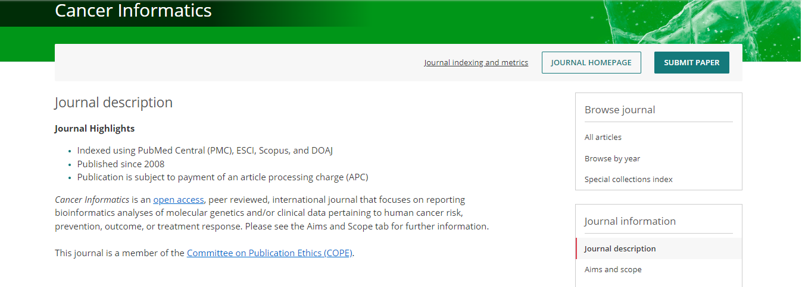
Journal
Homepage

Slide 4
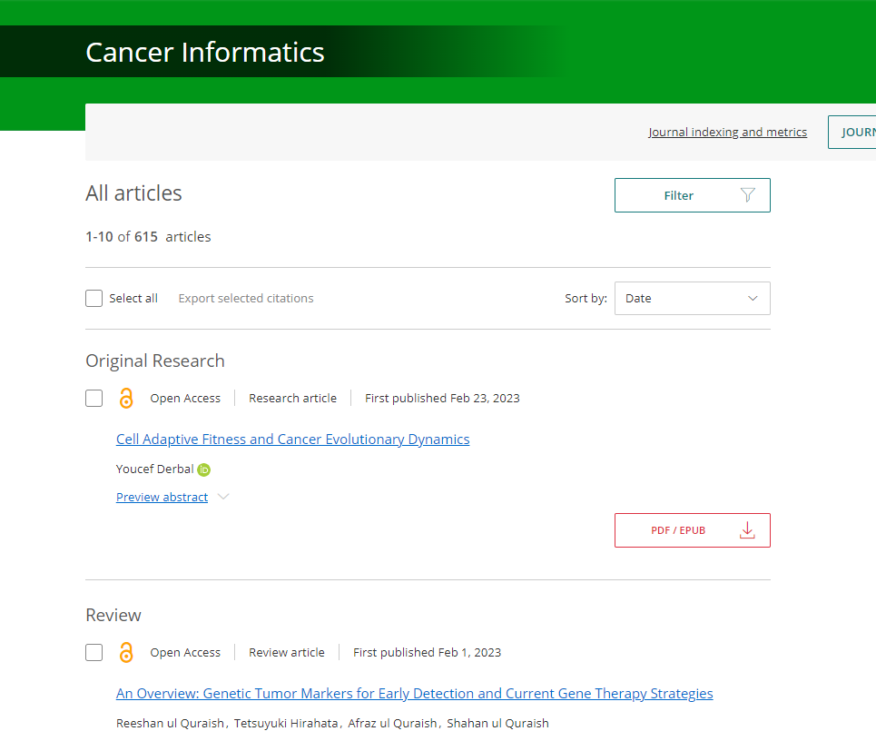
Articles
Homepage
Total Articles : 615

Slide 5
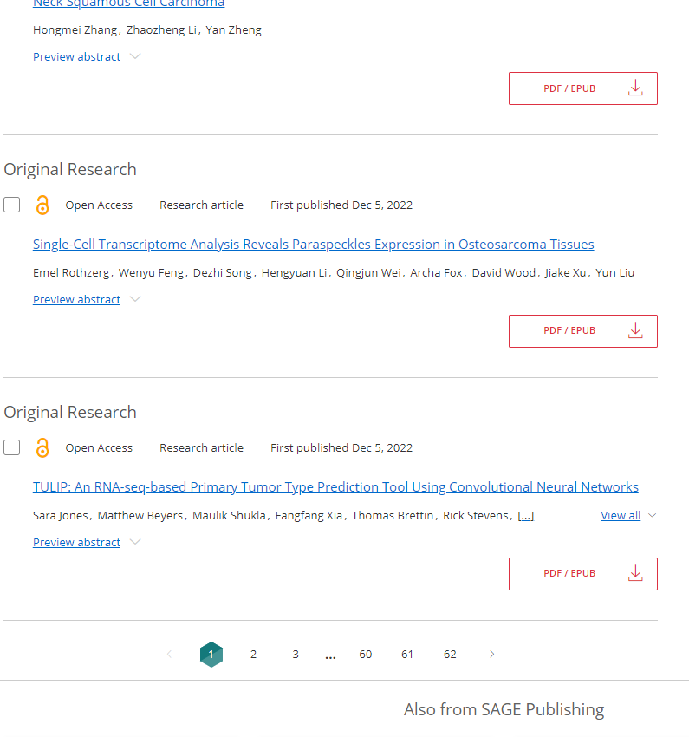
Articles Homepage
Total Pages : 62

Slide 6
Libraries Used
RVest
Xml2
ReadXL
StringR
Tidyr

Slide 7
Flow Of The Project
Read the HTML of the Journal page using Read_html.
Extracting the link from the HTML Element of the articles Homepage.
Finding the links of all the articles for extracting the text within.
Once completed, we can get the required data from all the 615 journals.
Creating a dataframe to store all the data within and give the output into a .txt file.

Slide 8
We will create a function “Extract Article Info(year)” and take year as an input and the function will loop over all the article links and extract information from all the matched articles.
The data would be stored into a dataframe and results would be displayed into a .txt file or a .xml file.
If there are no matches for the Input year in any articles then the dataframe would be empty.

Slide 9
COLLABORATION
Meetings were held using Zoom once every week.
Any problems faced in any part by any team member were shared into group chats and were addressed in the meetings.
CONTRIBUTIONS
RUSHIN : Discussions, Presentation.
ROQUE : Discussions, Presentation.
NAGESH : Discussions, Presentation.

